Slide 1
CS 61C: Great Ideas in Computer Architecture (Machine Structures) Performance and Floating-Point Arithmetic
Instructors:
Krste Asanovic & Vladimir Stojanovic
http://inst.eecs.berkeley.edu/~cs61c/

Slide 2
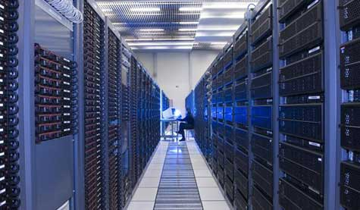
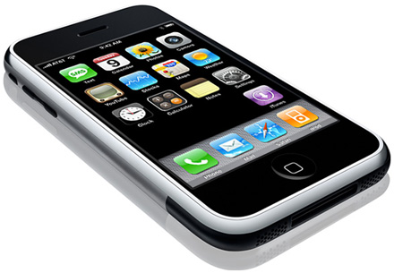
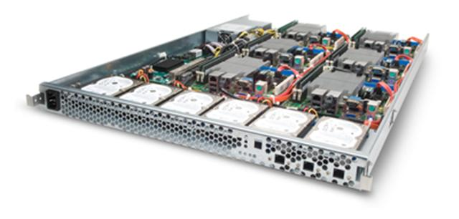
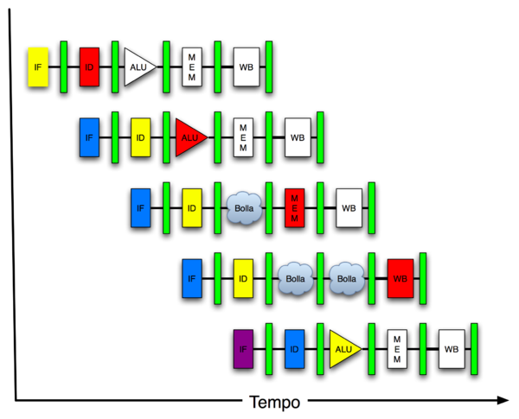
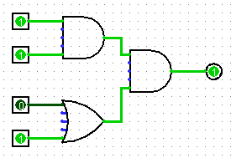
New-School Machine Structures (It’s a bit more complicated!)
Software Hardware
Parallel Requests
Assigned to computer
e.g., Search “Katz”
Parallel Threads
Assigned to core
e.g., Lookup, Ads
Parallel Instructions
>1 instruction @ one time
e.g., 5 pipelined instructions
Parallel Data
>1 data item @ one time
e.g., Add of 4 pairs of words
Hardware descriptions
All gates @ one time
Programming Languages
Warehouse Scale Computer
Smart Phone
Harness Parallelism &
Achieve High Performance
How do we know?
Computer
Core
…
Core
Memory (Cache)
Input/Output
Core
Instruction Unit(s)
Functional
Unit(s)
A₀+B₀
A₁+B₁
A₂+B₂
A₃+B₃
Cache Memory
Logic Gates

Slide 3
What is Performance?
Latency (or response time or execution time)
Time to complete one task
Bandwidth (or throughput)
Tasks completed per unit time

Slide 4
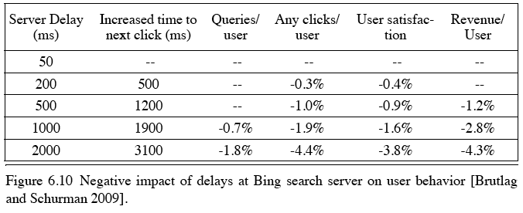
Cloud Performance: Why Application Latency Matters
Key figure of merit: application responsiveness
Longer the delay, the fewer the user clicks, the less the user happiness, and the lower the revenue per user

Slide 5


Defining CPU Performance
What does it mean to say X is faster than Y?
Ferrari vs. School Bus?
2013 Ferrari 599 GTB
2 passengers, 11.1 secs in quarter mile
2013 Type D school bus
54 passengers, quarter mile time?
http://www.youtube.com/watch?v=KwyCoQuhUNA
Response Time/Latency: e.g., time to travel ¼ mile
Throughput/Bandwidth: e.g., passenger-mi in 1 hour

Slide 6
Defining Relative CPU Performance
Performance_{X} = 1/Program Execution Time_{X}
Performance_{X} > Performance_{Y} => 1/Execution Time_{X} > 1/Execution Time_{y} => Execution Time_{Y} > Execution Time_{X}
Computer X is N times faster than Computer Y Performance_{X} / Performance_{Y} = N or Execution Time_{Y} / Execution Time_{X} = N
Bus is to Ferrari as 12 is to 11.1: Ferrari is 1.08 times faster than the bus!

Slide 7
Measuring CPU Performance
Computers use a clock to determine when events takes place within hardware
Clock cycles: discrete time intervals
aka clocks, cycles, clock periods, clock ticks
Clock rate or clock frequency: clock cycles per second (inverse of clock cycle time)
3 GigaHertz clock rate => clock cycle time = 1/(3x10⁹) seconds clock cycle time = 333 picoseconds (ps)

Slide 8
CPU Performance Factors
To distinguish between processor time and I/O, CPU time is time spent in processor
CPU Time/Program = Clock Cycles/Program x Clock Cycle Time
Or CPU Time/Program = Clock Cycles/Program ÷ Clock Rate

Slide 9
CPU Performance Factors
But a program executes instructions
CPU Time/Program = Clock Cycles/Program x Clock Cycle Time = Instructions/Program x Average Clock Cycles/Instruction x Clock Cycle Time
1st term called Instruction Count
2nd term abbreviated CPI for average Clock Cycles Per Instruction
3rd term is 1 / Clock rate

Slide 10
Restating Performance Equation
Time = Seconds Program Instructions Clock cycles Seconds Program Instruction Clock Cycle
=
×
×

Slide 11
What Affects Each Component? Instruction Count, CPI, Clock Rate
Hardware or software component? | Affects What?
Algorithm
Programming Language
Compiler
Instruction Set Architecture
Notes:
Algorithm Instruction count, possibly CPI
The algorithm determines the number of source program instructions executed and hence the number of processor instructions executed. The algorithm may also affect the CPI, by
favoring slower or faster instructions. For example, if the algorithm uses more floating-point operations, it will tend to have a higher CPI.
Programming language
Instruction count, CPI
The programming language certainly affects the instruction count, since statements in the language are translated to processor
instructions, which determine instruction count. The language mayalso affect the CPI because of its features; for example, a language
with heavy support for data abstraction (e.g., Java) will require indirect calls, which will use higher CPI instructions.
Compiler
Instruction count, CPI
The efficiency of the compiler affects both the instruction count and average cycles per instruction, since the compiler determines
the translation of the source language instructions into computer instructions. The compiler’s role can be very complex and affect
the CPI in complex ways.
Instruction set
architecture
Instruction count, clock rate, CPI
The instruction set architecture affects all three a
ts of CPU performance, since it affects the instructions needed for a
function, the cost in cycles of each instruction, and the overall clock rate of the processor

Slide 12
What Affects Each Component? Instruction Count, CPI, Clock Rate
Hardware or software component? | Affects What?
Algorithm | Instruction Count, CPI
Programming Language | Instruction Count, CPI
Compiler | Instruction Count, CPI
Instruction Set Architecture | Instruction Count, Clock Rate, CPI
Notes:
Algorithm Instruction count, possibly CPI
The algorithm determines the number of source program instructions executed and hence the number of processor instructions executed. The algorithm may also affect the CPI, by
favoring slower or faster instructions. For example, if the algorithm uses more floating-point operations, it will tend to have a higher CPI.
Programming language
Instruction count, CPI
The programming language certainly affects the instruction count, since statements in the language are translated to processor
instructions, which determine instruction count. The language mayalso affect the CPI because of its features; for example, a language
with heavy support for data abstraction (e.g., Java) will require indirect calls, which will use higher CPI instructions.
Compiler
Instruction count, CPI
The efficiency of the compiler affects both the instruction count and average cycles per instruction, since the compiler determines
the translation of the source language instructions into computer instructions. The compiler’s role can be very complex and affect
the CPI in complex ways.
Instruction set
architecture
Instruction count, clock rate, CPI
The instruction set architecture affects all three aspects of CPU performance, since it affects the instructions needed for a
function, the cost in cycles of each instruction, and the overall clock rate of the processor

Slide 13
Clickers:
Computer A clock cycle time 250 ps, CPI_{A} = 2
Computer B clock cycle time 500 ps, CPI_{B} = 1.2
Assume A and B have same instruction set
Which statement is true?
☐
A: Computer A is ≈1.2 times faster than B
☐
B: Computer A is ≈4.0 times faster than B
☐
C: Computer B is ≈1.7 times faster than A
☐
D: Computer B is ≈3.4 times faster than A
Notes:
VertLeftWhiteCheck1
Answer: Computer A is ≈1.2 times faster than B

Slide 14
Workload and Benchmark
Workload: Set of programs run on a computer
Actual collection of applications run or made from real programs to approximate such a mix
Specifies programs, inputs, and relative frequencies
Benchmark: Program selected for use in comparing computer performance
Benchmarks form a workload
Usually standardized so that many use them

Slide 15
SPEC (System Performance Evaluation Cooperative)
Computer Vendor cooperative for benchmarks, started in 1989
SPECCPU2006
12 Integer Programs
17 Floating-Point Programs
Often turn into number where bigger is faster
SPECratio: reference execution time on old reference computer divide by execution time on new computer to get an effective speed-up

Slide 16
SPECINT2006 on AMD Barcelona
Description | Instruc-tion Count (B) | CPI | Clock cycle time (ps) | Execu-tion Time (s) | Refer-ence Time (s) | SPEC-ratio
Interpreted string processing | 2,118 | 0.75 | 400 | 637 | 9,770 | 15.3
Block-sorting compression | 2,389 | 0.85 | 400 | 817 | 9,650 | 11.8
GNU C compiler | 1,050 | 1.72 | 400 | 724 | 8,050 | 11.1
Combinatorial optimization | 336 | 10.0 | 400 | 1,345 | 9,120 | 6.8
Go game | 1,658 | 1.09 | 400 | 721 | 10,490 | 14.6
Search gene sequence | 2,783 | 0.80 | 400 | 890 | 9,330 | 10.5
Chess game | 2,176 | 0.96 | 400 | 837 | 12,100 | 14.5
Quantum computer simulation | 1,623 | 1.61 | 400 | 1,047 | 20,720 | 19.8
Video compression | 3,102 | 0.80 | 400 | 993 | 22,130 | 22.3
Discrete event simulation library | 587 | 2.94 | 400 | 690 | 6,250 | 9.1
Games/path finding | 1,082 | 1.79 | 400 | 773 | 7,020 | 9.1
XML parsing | 1,058 | 2.70 | 400 | 1,143 | 6,900 | 6.0

Slide 17
Summarizing Performance …
System
Rate (Task 1)
Rate (Task 2)
A
10
20
B
20
10
Clickers: Which system is faster?
A: System A
B: System B
C: Same performance
D: Unanswerable question!

Slide 18
… Depends Who’s Selling
System
Rate (Task 1)
Rate (Task 2)
Average
A
10
20
15
B
20
10
15
Average throughput
System
Rate (Task 1)
Rate (Task 2)
Average
A
0.50
2.00
1.25
B
1.00
1.00
1.00
Throughput relative to B
System
Rate (Task 1)
Rate (Task 2)
Average
A
1.00
1.00
1.00
B
2.00
0.50
1.25
Throughput relative to A

Slide 19

Summarizing SPEC Performance
Varies from 6x to 22x faster than reference computer
Geometric mean of ratios: N-th root of product of N ratios
Geometric Mean gives same relative answer no matter what computer is used as reference
Geometric Mean for Barcelona is 11.7

Slide 20
Administrivia
Project 2, Part 2 due 3/22
No assigned work over spring break
Next assignment, HW5, due 04/05
Midterm II is 04/09
Conflict? Email Sagar
DSP to receive email about accommodations soon

Slide 21
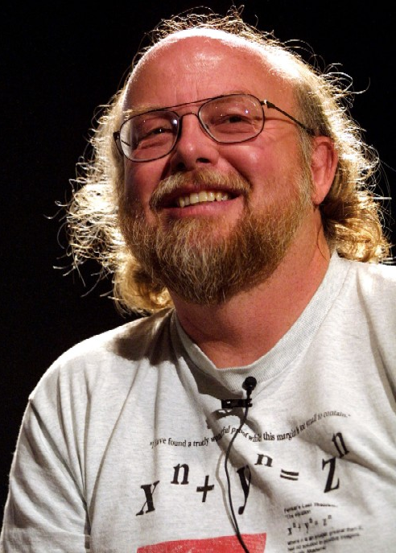
Quote of the day
“95% of the folks out there are completely clueless about floating-point.”
James Gosling Sun Fellow Java Inventor 1998-02-28
The same has been said about Java’s FP design…

Slide 22
Review of Numbers
Computers are made to deal with numbers
What can we represent in N bits?
2^{N} things, and no more! They could be…
Unsigned integers:
0 to 2^{N} - 1
(for N=32, 2^{N}–1 = 4,294,967,295)
Signed Integers (Two’s Complement)
-2^{(N-1)} to 2^{(N-1)} - 1
(for N=32, 2^{(N-1)} = 2,147,483,648)

Slide 23
What about other numbers?
Very large numbers? (seconds/millennium) ⇒ 31,556,926,000₁₀ (3.1556926₁₀ x 10¹⁰)
Very small numbers? (Bohr radius) ⇒ 0.0000000000529177₁₀m (5.29177₁₀ x 10⁻¹¹)
Numbers with both integer & fractional parts? ⇒ 1.5
First consider #3.
…our solution will also help with 1 and 2.

Slide 24
Representation of Fractions
“Binary Point” like decimal point signifies boundary between integer and fractional parts:
xx.yyyy
Example 6-bit representation:
2¹
2⁻⁴
2⁰
2⁻¹
2⁻²
2⁻³
10.1010₂ = 1x2¹ + 1x2⁻¹ + 1x2⁻³ = 2.625₁₀
If we assume “fixed binary point”, range of 6-bit representations with this format:
0 to 3.9375 (almost 4)

Slide 25
Fractional Powers of 2
i 2^{-i}
0 1.0 1
0.5 1/2
0.25 1/4
0.125 1/8
0.0625 1/16
0.03125 1/32
0.015625
0.0078125
0.00390625
0.001953125
0.0009765625
0.00048828125
0.000244140625
0.0001220703125
0.00006103515625
0.000030517578125

Slide 26
Representation of Fractions with Fixed Pt.
What about addition and multiplication?
Addition is straightforward:
01.100 1.5₁₀
+ 00.100 0.5₁₀
10.000 2.0₁₀
01.100 1.5₁₀
00.100 0.5₁₀
00 000
000 00
0110 0
00000
00000
0000110000
Multiplication a bit more complex:
Where’s the answer, 0.11? (need to remember where point is)

Slide 27
Representation of Fractions
So far, in our examples we used a “fixed” binary point what we really want is to “float” the binary point. Why?
Floating binary point most effective use of our limited bits (and thus more accuracy in our number representation):
example: put 0.1640625 into binary. Represent as in 5-bits choosing where to put the binary point.
… 000000.001010100000…
Store these bits and keep track of the binary point 2 places to the left of the MSB
Any other solution would lose accuracy!
With floating-point rep., each numeral carries a exponent field recording the whereabouts of its binary point.
The binary point can be outside the stored bits, so very large and small numbers can be represented.

Slide 28
Scientific Notation (in Decimal)
mantissa
exponent
6.02₁₀ x 10²³
decimal point
radix (base)
Normalized form: no leadings 0s (exactly one digit to left of decimal point)
Alternatives to representing 1/1,000,000,000
Normalized: 1.0 x 10⁻⁹
Not normalized: 0.1 x 10⁻⁸,10.0 x 10⁻¹⁰

Slide 29
Scientific Notation (in Binary)
mantissa
exponent
1.01_{two} x 2⁻¹
“binary point”
radix (base)
Computer arithmetic that supports it called floating point, because it represents numbers where the binary point is not fixed, as it is for integers
Declare such variable in C as float
Or double for double precision.

Slide 30
Floating-Point Representation (1/2)
Normal format: +1.xxx…x_{two}*2^{yyy…y}two
Multiple of Word Size (32 bits)
31
30
23
22
0
S
Exponent
Significand
1 bit
8 bits
23 bits
S represents Sign Exponent represents y’s Significand represents x’s
Represent numbers as small as 2.0 x 10⁻³⁸ to as large as 2.0 x 10³⁸

Slide 31
Floating-Point Representation (2/2)
What if result too large?
(> 2.0x10³⁸ , < -2.0x10³⁸ )
Overflow! ⇒ Exponent larger than represented in 8-bit Exponent field
What if result too small?
(>0 & < 2.0x10⁻³⁸ , <0 & > -2.0x10⁻³⁸ )
Underflow! ⇒ Negative exponent larger than represented in 8-bit Exponent field
What would help reduce chances of overflow and/or underflow?
overflow
underflow
overflow
-2x10³⁸
-1
-2x10⁻³⁸
0
2x10⁻³⁸
1
2x10³⁸

Slide 32
IEEE 754 Floating-Point Standard (1/3)
Single Precision (Double Precision similar):
Sign bit: 1 means negative 0 means positive
Significand in sign-magnitude format (not 2’s complement)
To pack more bits, leading 1 implicit for normalized numbers
1 + 23 bits single, 1 + 52 bits double
always true: 0 < Significand < 1 (for normalized numbers)
Note: 0 has no leading 1, so reserve exponent value 0 just for number 0
31
30
23
22
0
S
Exponent
Significand
1 bit
8 bits
23 bits

Slide 33
IEEE 754 Floating Point Standard (2/3)
IEEE 754 uses “biased exponent” representation.
Designers wanted FP numbers to be used even if no FP hardware; e.g., sort records with FP numbers using integer compares
Wanted bigger (integer) exponent field to represent bigger numbers.
2’s complement poses a problem (because negative numbers look bigger)
We’re going to see that the numbers are ordered EXACTLY as in sign-magnitude
I.e., counting from binary odometer 00…00 up to 11…11 goes from 0 to +MAX to -0 to -MAX to 0

Slide 34
IEEE 754 Floating Point Standard (3/3)
Called Biased Notation, where bias is number subtracted to get real number
IEEE 754 uses bias of 127 for single prec.
Subtract 127 from Exponent field to get actual value for exponent
1023 is bias for double precision
Summary (single precision):
31
30
23
22
0
S
Exponent
Significand
1 bit
8 bits
23 bits
(-1)^{S} x (1 + Significand) x 2^{(Exponent-127)}
Double precision identical, except with exponent bias of 1023 (half, quad similar)

Slide 35

“Father” of the Floating point standard
IEEE Standard 754 for Binary Floating-Point Arithmetic.
1989 ACM Turing Award Winner!
Prof. Kahan
www.cs.berkeley.edu/~wkahan/ieee754status/754story.html
Notes:
1:30 in

Slide 36
Representation for ± ∞
In FP, divide by 0 should produce ± ∞, not overflow.
Why?
OK to do further computations with ∞ E.g., X/0 > Y may be a valid comparison
Ask math majors
IEEE 754 represents ± ∞
Most positive exponent reserved for ∞
Significands all zeroes

Slide 37
Representation for 0
Represent 0?
exponent all zeroes
significand all zeroes
What about sign? Both cases valid.
+0: 0 00000000 00000000000000000000000
-0: 1 00000000 00000000000000000000000

Slide 38
Special Numbers
What have we defined so far? (Single Precision)
Exponent Significand Object
0 0 0
0 nonzero ???
1-254 anything +/- fl. pt. #
255 0 +/- ∞
255 nonzero ???
Professor Kahan had clever ideas; “Waste not, want not”
Wanted to use Exp=0,255 & Sig!=0

Slide 39
Representation for Not a Number
What do I get if I calculate sqrt(-4.0)or 0/0?
If ∞ not an error, these shouldn’t be either
Called Not a Number (NaN)
Exponent = 255, Significand nonzero
Why is this useful?
Hope NaNs help with debugging?
They contaminate: op(NaN, X) = NaN
Can use the significand to identify which!

Slide 40
Representation for Denorms (1/2)
Problem: There’s a gap among representable FP numbers around 0
Smallest representable pos num:
a = 1.0… ₂ * 2⁻¹²⁶ = 2⁻¹²⁶
Second smallest representable pos num:
b = 1.000……1 ₂ * 2⁻¹²⁶ = (1 + 0.00…1₂) * 2⁻¹²⁶ = (1 + 2⁻²³) * 2⁻¹²⁶ = 2⁻¹²⁶ + 2⁻¹⁴⁹
a - 0 = 2⁻¹²⁶
b - a = 2⁻¹⁴⁹
Normalization and implicit 1 is to blame!
Gaps!
b
-
+
0
a

Slide 41
Representation for Denorms (2/2)
Solution:
We still haven’t used Exponent = 0, Significand nonzero
DEnormalized number: no (implied) leading 1, implicit exponent = -126.
Smallest representable pos num:
a = 2⁻¹⁴⁹
Second smallest representable pos num:
b = 2⁻¹⁴⁸
-
+
0

Slide 42
Special Numbers Summary
Reserve exponents, significands:
Exponent Significand Object
0 0 0
0 nonzero Denorm
1-254 anything +/- fl. pt. #
255 0 +/- ∞
255 nonzero NaN

Slide 43
Conclusion
www.h-schmidt.net/FloatApplet/IEEE754.html
Exponent tells Significand how much (2^{i}) to count by (…, 1/4, 1/2, 1, 2, …)
Floating Point lets us:
Represent numbers containing both integer and fractional parts; makes efficient use of available bits.
Store approximate values for very large and very small #s.
IEEE 754 Floating-Point Standard is most widely accepted attempt to standardize interpretation of such numbers (Every desktop or server computer sold since ~1997 follows these conventions)
Can store NaN, ± ∞
Summary (single precision):
31
30
23
22
0
S
Exponent
Significand
1 bit
8 bits
23 bits
(-1)^{S} x (1 + Significand) x 2^{(Exponent-127)}
Double precision identical, except with exponent bias of 1023 (half, quad similar)

Slide 44
And In Conclusion, …
Time (seconds/program) is measure of performance Instructions Clock cycles Seconds Program Instruction Clock Cycle
Floating-point representations hold approximations of real numbers in a finite number of bits
=
×
×

